Slide 1

DBMS MINI PROJECT
Dr. AMBEDKAR INSTITUTE OF TECHNOLOGY
Near Jnana Bharathi Campus, Bengaluru-560 056.
(An Autonomous Institution, Aided by Government of Karnataka)
Department of computer science & engineering 2023-24
Course Code : 21CLS505
Mini project on
“Streamlining Room Management and Rentals”
Bachelor of engineering in
Computer science and engineering

Slide 2
Streamlining Room Management and Rentals:
PROJECT MEMBERS:
1DA21CS092: NADDANA YASHWANTH
BACKEND:
Design Of Schema.
Listing Schema.
Review Schema.
User Schema .
With Schema and Entity Rational Diagrams.
1DA22CS409: HAJARATALI S MOGALLAI
FRONTEND:
BACKEND:
Index page
Show page
Commenting
Review
With Express js
Writing Routes
Writing Methods
With node js

Slide 3
Project Overview:
The project seems to be a property rental and listing platform where users can browse, create, and manage property listings. It includes features for creating, updating, and deleting property listings, managing reviews, categorizing listings by type, and implementing a search functionality. Additionally, there are modules for user authentication, menu management, and the creation of rental menus associated with specific listings.
Key Features and Functionalities:
Property Listings:
Users can view a list of all property listings on the homepage.
Detailed information about each listing, including images, is displayed on individual listing pages.
The project allows for the creation, editing, and deletion of property listings.
User Authentication:
Users can sign up for accounts, log in, and log out.
Authentication is integrated with Passport.js, providing secure user registration and login processes.
Menu Management:
There is a module for creating and managing menus associated with specific listings.
Menus include information about different items, and users can create, edit, and delete menu items.
Search Functionality:
The project includes a search feature allowing users to search for listings based on titles, categories, or locations.
Listing Categories:
Property listings are categorized based on types such as Cottage, Residential, Commercial, Vacation, Apartment, Condo, Townhouse, and Other.

Slide 4
Review System:
Users can leave reviews for specific property listings.
The reviews are associated with the respective listings and are displayed on the listing detail pages.
User Profile:
Users have profiles where they can manage their information and potentially view their rental history.
Trending Listings:
There is a module to display trending listings based on reviews with a rating of 5.
Search Functionality:
Users can perform searches for listings based on titles, categories, and locations.
Error Handling and Flash Messages:
The project includes error handling to manage potential issues during user interactions.
Flash messages are used to provide feedback to users after certain operations.
Additional Modules:
Menu Integration:
There is a separate set of modules related to menu creation and management, allowing users to add menus to specific listings.
User Authentication and Authorization:
Passport.js is used for user authentication, providing a secure and customizable authentication system.
Rental Module:
There is a module related to renting properties, allowing users to book and manage rental periods.

Slide 5
Considerations:
The project appears to be built using a Node.js framework, possibly Express.js, and is likely connected to a MongoDB database.
Middleware like connect-flash is used for displaying flash messages to users.
File uploads, possibly for listing images, are handled using middleware that works with file paths and filenames.

Slide 6
Streamlining Room Management and Rentals:
BACKEND: Design Of Schema.
User:
User_id | User_name | User_email | User_password | Rents_Id | Menu_Id
Listing:
Listing_Id | Title | Description | Image | Category | Price | City | Location | Reviews_id | Owner_id
Reviews:
Reviews_id | Comments | Rating | Createdat | Author_id | Listing_Id
Rent:
Rent_id | SatartDate | EndDate | Listing_Id
Menu:
Menu_id | Item_type | Food_item | price | Listing_id

Slide 7
Streamlining Room Management and Rentals:
BACKEND: E-R Diagram.
comment
Author_id
Title
City
Menu_Id
Review_id
Created_at
listing_id
id (PK)
Image
Description
Rating
Price
N
Listing
1
Reviews
Revies for listing
N
Rents_Id
end_date
Location
N
M
Revies from users
listing_id
M
category
Can rent
List the property
1
1
start_date
The menu for listing
User
1
Rents_id
N
1
listing_id
user_id
N
User can rent
N
Orders
Username
Rents
Menu
N
food_items
user_id
Email
price
menu_id
item_type
user_id

Slide 8
BACKEND: Backend-Data
All Shema's in mongoose using MongoDB:
User Schema:
Review Schema:
const mongoose = require('mongoose');
const userSchema = new mongoose.Schema({
username: String,
email: String,
password: String
});
const User = mongoose.model('User', userSchema);
module.exports = User;
const mongoose = require('mongoose');
const reviewSchema = new mongoose.Schema({
property_id: mongoose.Schema.Types.ObjectId,
user_id: mongoose.Schema.Types.ObjectId,
rating: Number,
comment: String
});
const Review = mongoose.model('Review', reviewSchema);
module.exports = Review;

Slide 9
BACKEND: Backend-Data
All Shema's in mongoose using MongoDB:
listing Schema
Rent Schema
const mongoose = require('mongoose');
const propertySchema = new mongoose.Schema({
title: String,
description: String,
image: { url: String, filename: String },
price: Number,
location: String,
country: String,
category: String,
owner_id: mongoose.Schema.Types.ObjectId,
reviews: [{ type: mongoose.Schema.Types.ObjectId, ref: 'Review' }],
__v: Number
});
const Property = mongoose.model('Property', propertySchema);
module.exports = Property;
const mongoose = require('mongoose');
const rentSchema = new mongoose.Schema({
property_id: mongoose.Schema.Types.ObjectId,
start_date: Date,
end_date: Date
});
const Rent = mongoose.model('Rent', rentSchema);
module.exports = Rent;

Slide 10
BACKEND: Backend-Data
All Shema's in mongoose using MongoDB:
Menu Schema:
const mongoose = require('mongoose');
const menuSchema = new mongoose.Schema({
property_id: mongoose.Schema.Types.ObjectId,
dish_name: String
});
const Menu = mongoose.model('Menu', menuSchema);
module.exports = Menu;

Slide 11
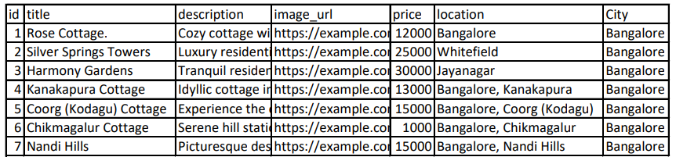
Quires and Back end Data:
BACKEND: Backend-Data
const listings = await listing.find({});

Slide 12
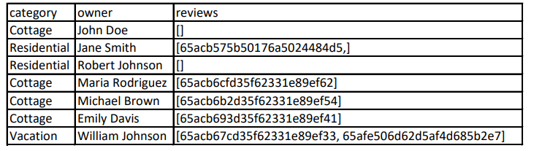
Quires and Back end Data:
BACKEND: Backend-Data
const listings = await listing.find({});

Slide 13
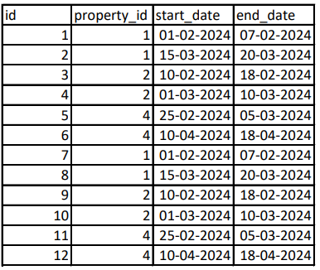
BACKEND: Backend-Data
Quires and Back end Data:
const rents = await Rent.find({});

Slide 14
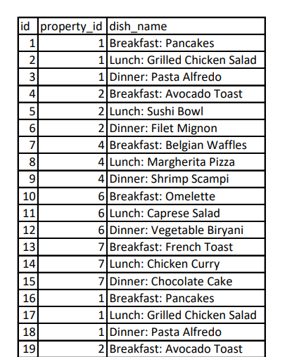
BACKEND: Backend-Data
Quires and Back end Data:
const menuItems = await Menu.find({});

Slide 15
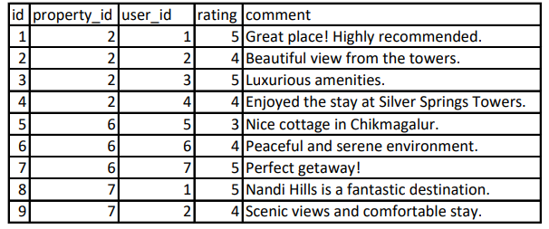
BACKEND: Backend-Data
Quires and Back end Data:
const reviews = await Review.find({});

Slide 16
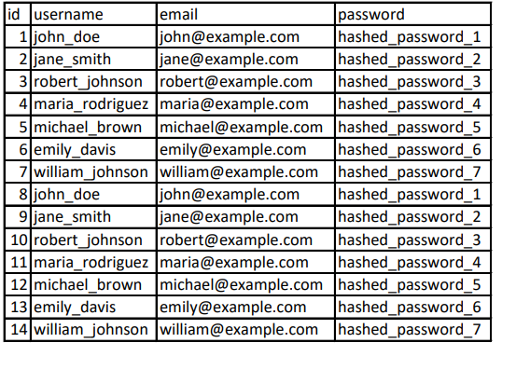
Quires and Back end Data:
BACKEND: Backend-Data
const users = await User. Find({});

Slide 17
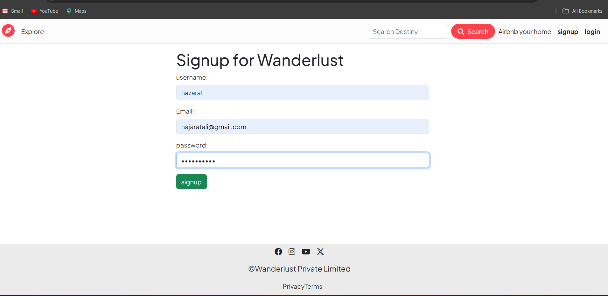
Signup page /from

Slide 18
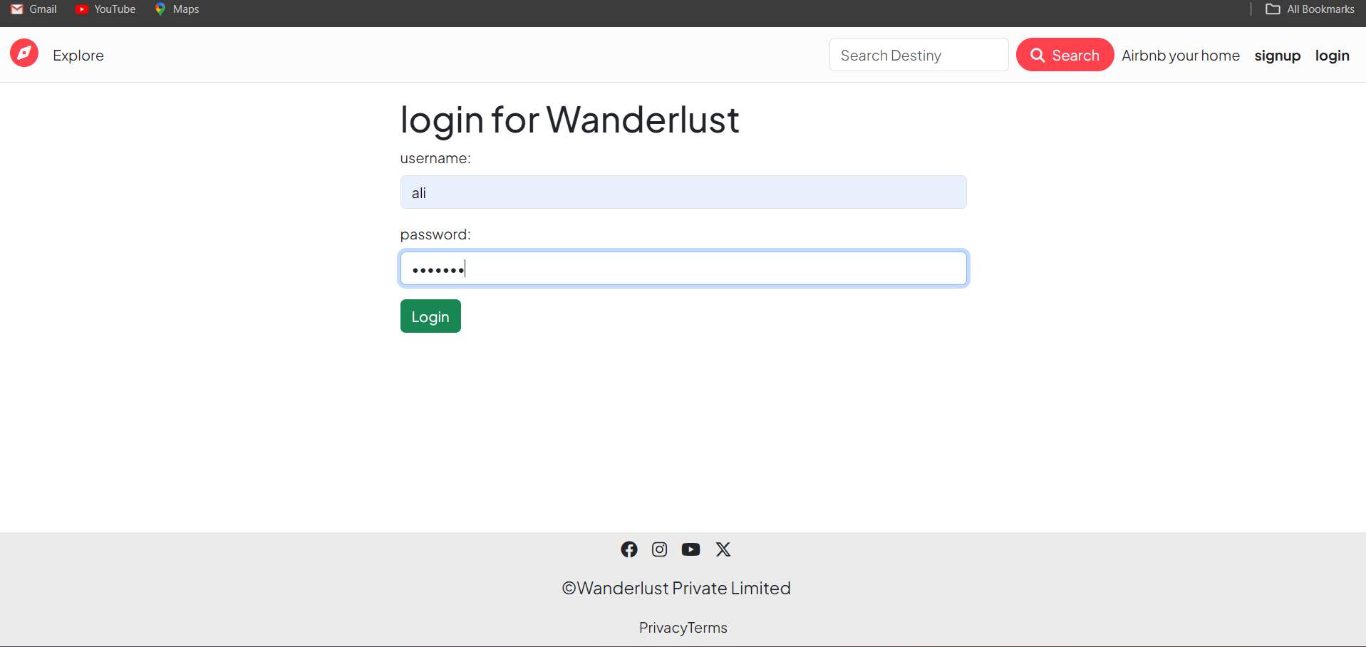
Login from

Slide 19
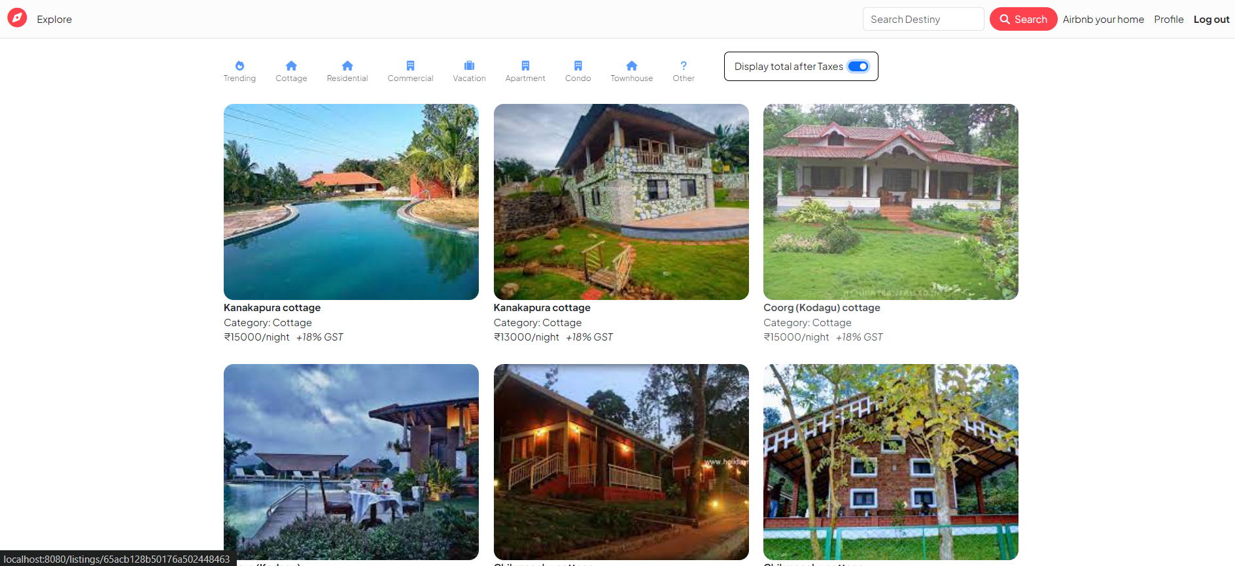
Front End:
The Front-End snapshots
Main page / Index page

Slide 20
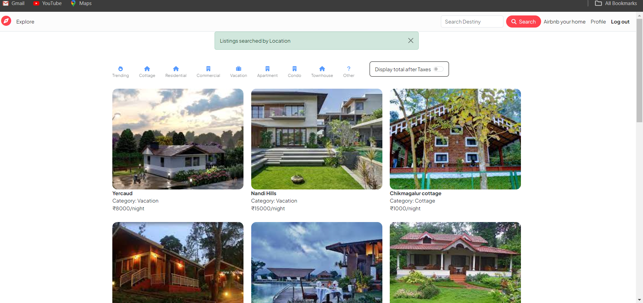
Main page / Index page

Slide 21
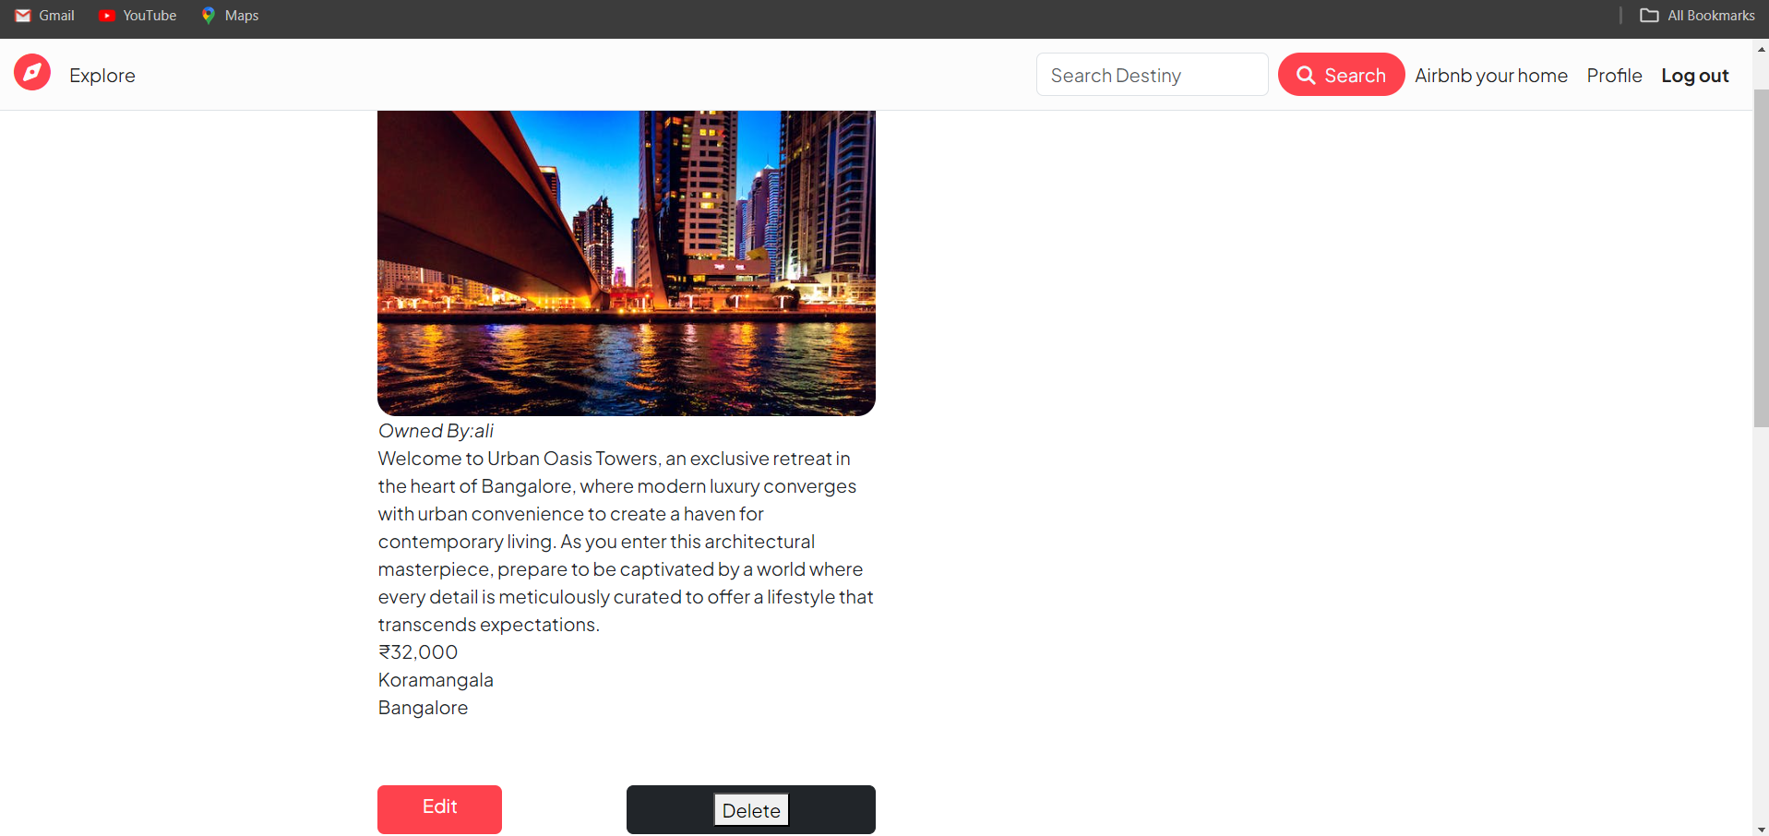
Show Page Details of listing

Slide 22

Review From

Slide 23
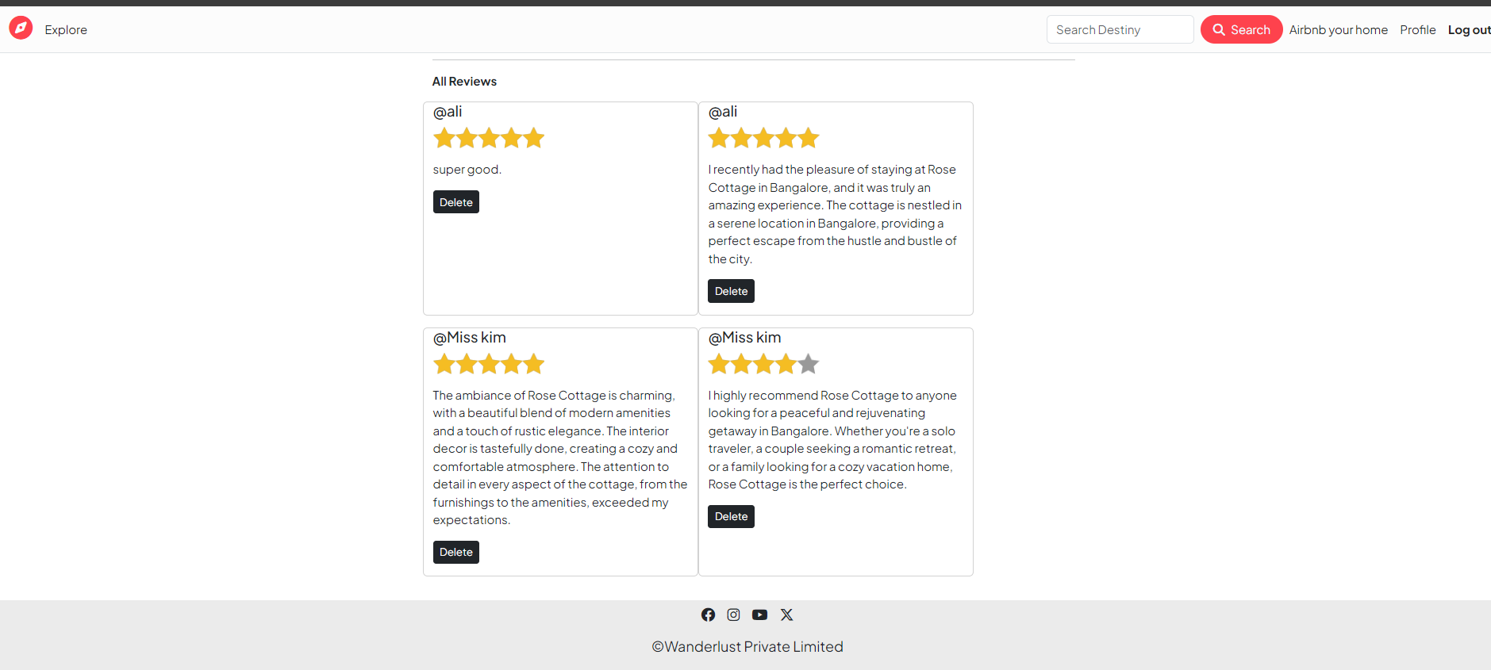
All Reviews

Slide 24
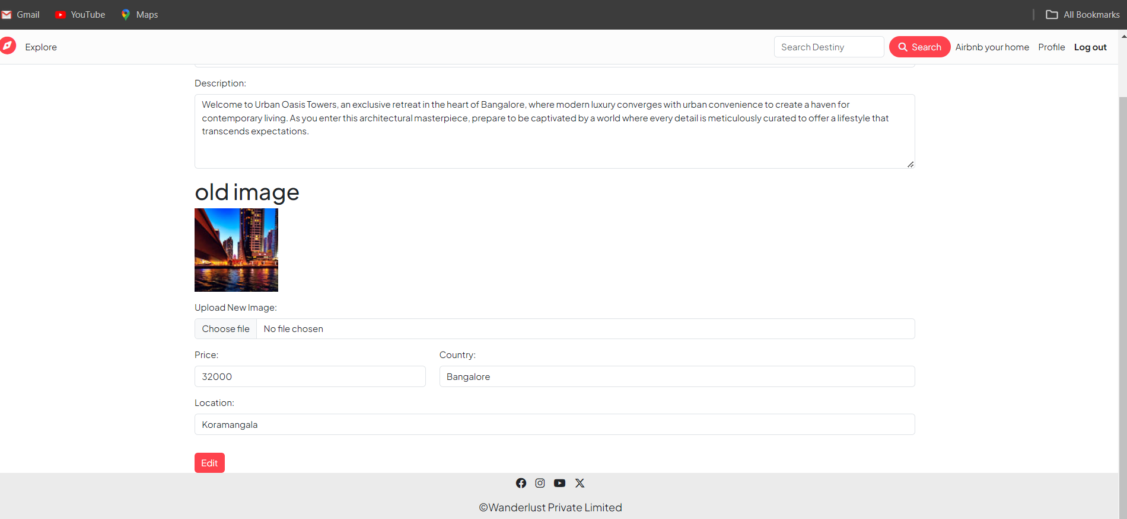
Edit from

Slide 25

Reviews

Slide 26
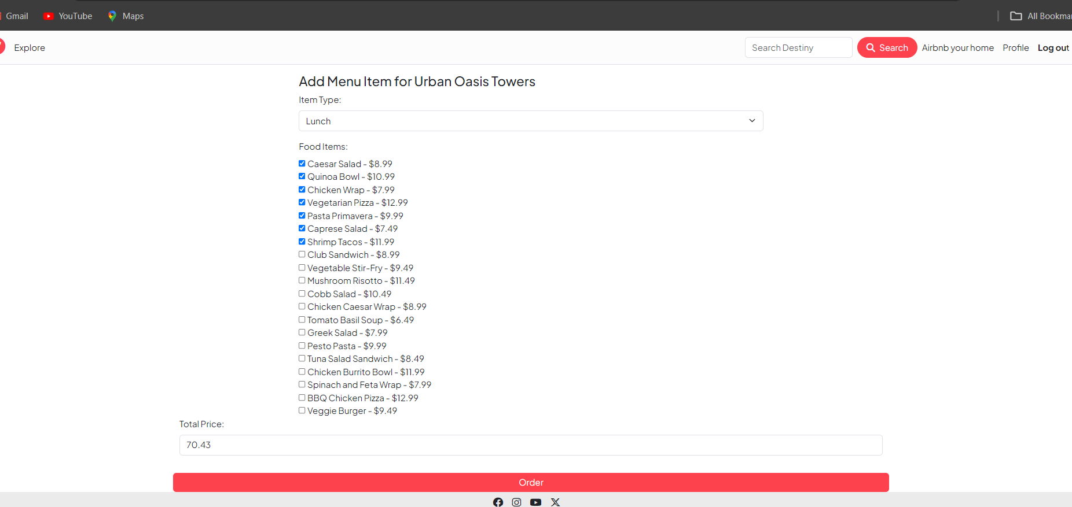
Menu-Lunch

Slide 27
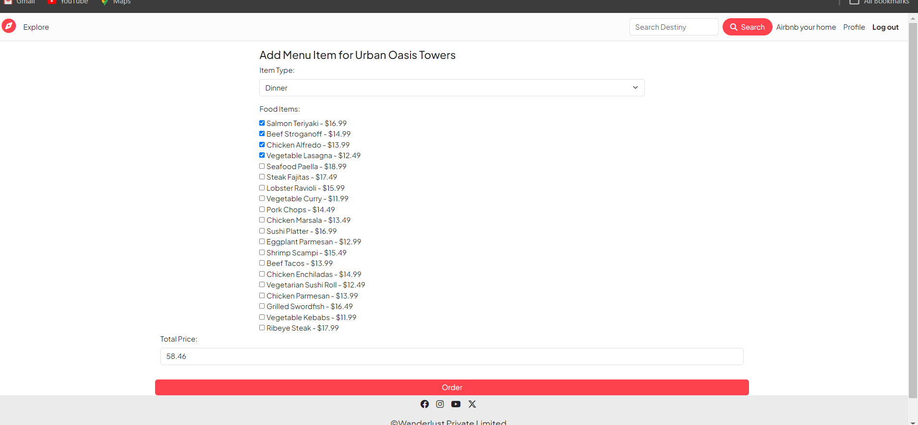
Menu-Dinner

Slide 28
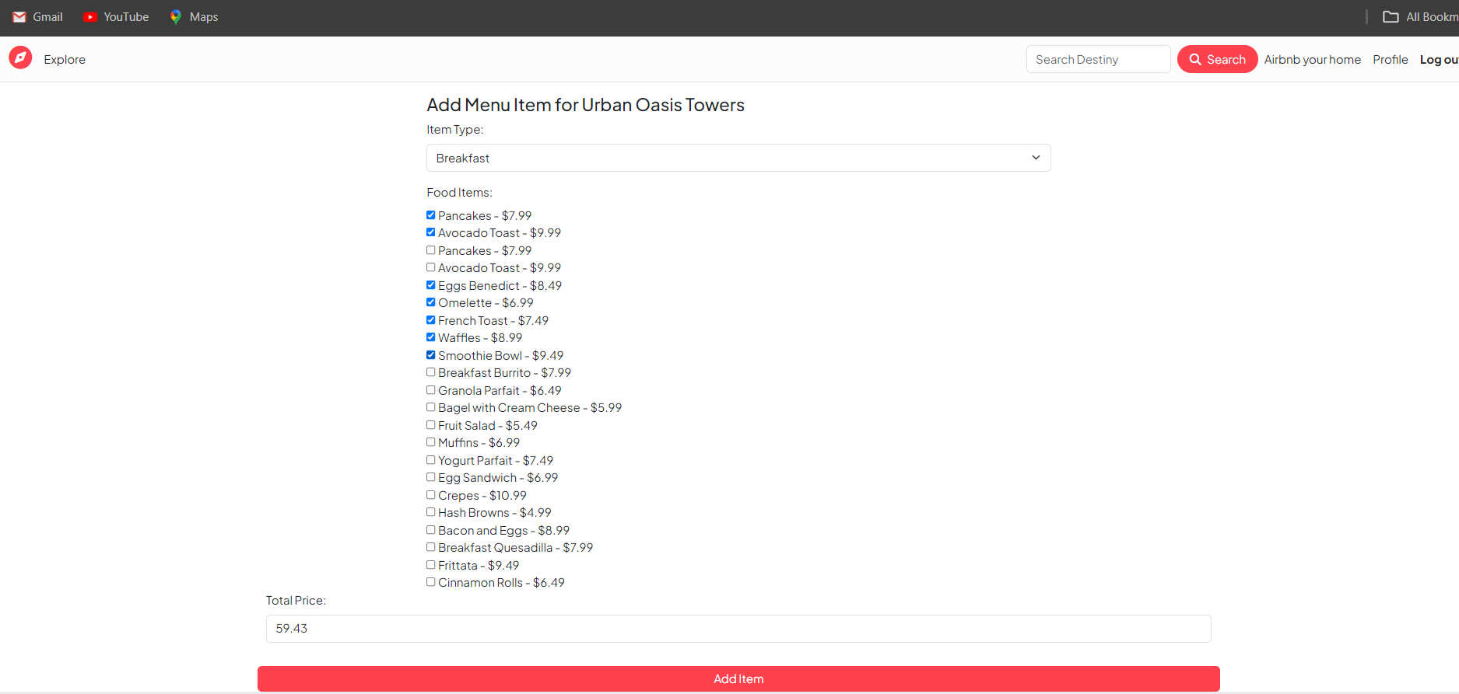
Menu-Breakfast

Slide 29
All Quires from All Modules
Retrieve all listings:
const All Listings = await Listing.find({});
New Form Module:
Render the form for creating a newlisting:res.render("listing/new.ejs");
Show Listing Module:
Retrieve a specific listing by ID and populate its reviews and owner:
const listing = await Listing.findById(id).populate({ path: "reviews", populate: { path: "author" } }).populate("owner");
Create New Listing Module:
Create a new listing with the provided data and save it to the database.
Edit Listing Module:
Retrieve a specific listing by ID for editing:const listing = await Listing.findById(id);
Update Listing Module:
Update an existing listing with the provided data and image (if provided).
Delete Listing Module:
Delete a listing by ID :let deleted = await Listing.findByIdAndDelete(id);

Slide 30
To retrieve listings based on different categories
// Example for retrieving Cottage listings
const cottageListings = await Cottage(req, res);
// Example for retrieving Residential listings
const residentialListings = await Residential(req, res);
// Example for retrieving Commercial listings
const commercialListings = await Commercial(req, res);
// Example for retrieving Vacation listings
const vacationListings = await Vacation(req, res);
// Example for retrieving Apartment listings
const apartmentListings = await Apartment(req, res);
// Example for retrieving Condo listings
const condoListings = await Condo(req, res);
// Example for retrieving Townhouse listings
const townhouseListings = await Townhouse(req, res);
// Example for retrieving Other listings
const otherListings = await Other(req, res);

Slide 31
getMenuForm:
Retrieve a specific listing by ID and populate its 'menu' field: const listingId = req.params.id;
const listing = await Listing.findById(listingId).populate('menu’);
storeMenu:
Extract data from the request body:const listingId = req.params.id;
const { itemType, foodItems, price } = req.body.item;
Find the listing with the specified ID:const listing = await Listing.findById(listingId);
Create a new Menu item:
const newMenuItem = new Menu({
itemType,
foodItems,
price,
});
Push the new menu item to the 'menu' array of the listing:
listing.menu.push(newMenuItem);
Save changes to the listing:await listing.save();

Slide 32
Fetch Listing:Query to fetch a specific listing by its ID.
const listing = await Listing.findById(req.params.id);
Handle Listing Not Found:Check if the listing exists. If not, flash an error message and redirect.
if (!listing) { req.flash('error', 'Listing not found'); return res.redirect('/'); }
Create Rent Instance:Extract start and end dates from the request body.
Create a new Rent instance with the extracted dates.
const rental = new Rent({ startDate, end Date, });
Save Rental:Save the rental to the database using rental.save().await rental.save();
Update Listing with Rental:Ensure the rents array is initialized in the listing.
Push the rental into the rents array of the listing.
Save the changes to the listing.
listing.rents = listing.rents || [];
listing.rents.push(rental); await listing.save();
Flash Success Message:
Flash a success message indicating that the listing has been successfully rented.
req.flash('success', 'Successfully rented the listing!’);
Redirect:
Redirect to the page displaying details of the rented listing.
res.redirect(`/listings/${listing.id}`);

Slide 33
CreateReview:
Fetch the listing by its ID:
let listing = await Listing.findById(req.params.id);
Create a new Review instance with the data from the request body:
let NewReview = new Review(req.body.review);
Set the author of the review to the current user's ID:
NewReview.author = req.user._id;
Push the new review into the reviews array of the listing:
listing.reviews.push(NewReview);
Save the new review and the updated listing:
await NewReview.save(); await listing.save();
DeleteReview:
Retrieve the listing ID and review ID from the request parameters:
let { id, reviewId } = req.params;
Use findByIdAndUpdate to pull the specified review ID from the reviews array of the listing:
await Listing.findByIdAndUpdate(id, { $pull: { reviews: reviewId } });
Use findByIdAndDelete to delete the specified review:
await Review.findByIdAndDelete(reviewId);

Slide 34
SignupUpForm:
Purpose: Render the signup form.
res.render("../views/users/signup.ejs");
SignUpUser:
Purpose: Create a new user account.
Steps:
Extract username, email, and password from the request body.
Create a new User instance with the provided email and username.
Use User.register method to register the user with the provided password.
Log in the registered user and redirect to the listings page.
let newUser = new User({ email, username }); const registeredUser = await User.register(newUser, password); req.login(registeredUser, (err) => { /* ... */ });
userprofile:
Purpose: Render the user profile page.
res.render("users/usetprofile.ejs");

Slide 35
LoginForm:
Purpose: Render the login form.
res.render("users/login.ejs");
LoginByUser:
Purpose: Log in a user
req.flash('success', "Welcome Back to wanderlust ");
let redirectUrl = res.locals.redirectUrl || "/listings"; res.redirect(redirectUrl);
LogOut:
Purpose: Log out the currently authenticated user.
req.logout((err) => { /* ... */ });

Slide 36
Reservation System
Centralized Reservation System:
Implement a centralized reservation system using Property Management Software (PMS).
Ensure real-time updates to prevent overbooking.
Enable seamless communication between front-desk operations and online booking platforms.
Online Booking
Online Booking Platforms:
Provide a user-friendly online booking platform for guests.
Integrate the online booking system with the centralized reservation system for real-time data synchronization.
Check-In and Check-Out Automation
Automated Check-In and Check-Out:
Implement automated processes to minimize guest waiting times.
Explore mobile check-in options for increased guest convenience.
Pricing Optimization
Dynamic Pricing Strategies:
Implement dynamic pricing based on demand, seasonality, and other factors.
Utilize analytics and historical data to optimize pricing decisions.

Slide 37
Menu Creation and Configuration
Menu Setup:
Define the types of items to be offered in the menu (e.g., appetizers, main courses, beverages).
Specify the structure and layout of the menu.
Item Configuration:
Add and configure individual menu items.
Include details such as item name, description, category, and pricing.
Attach images to visually represent each menu item.

Slide 38

THANK YOU
FOR WATCHING
Thank you

